Slide 1


Department of Computer Science and Engineering
Academic Year (2026-27) | 22CSE74 : Project Phase-II
KRUSHIKADHARA: AN AI-POWERED MULTIMODAL CROP DIAGNOSTICS, REAL-TIME STAGE ADVISORY, AND APMC MARKET INTELLIGENCE ECOSYSTEM FOR SMALLHOLDER FARMERS
Team Members
1NH24CS409 - NAVEEN KUMAR KM (Lead)
1NH23CS029 - ARUN VIRAKTAMATH
1NH23CS080 - G. MOHNISH
1NH23CS060 - P. CHANDRASHEKHAR
Under the Guidance of
1. Dr. Raja Meyyan, Professor & HoD, Dept. of CSE, NHCE
2. Dr. Soja Rani S, Associate Professor, Dept. of CSE, NHCE

Slide 2
OUTLINE OF THE PRESENTATION
1. Abstract
2. Introduction - Background, Problem & Objectives
3. Proposed System Architecture & Deep Dive
4. System Analysis - Requirements & Specifications
5. Comparison with Existing Systems
6. Results and Discussions - Accuracy & Live Demo
7. Cost Analysis & Economic Viability
8. Public Health, Safety & Environmental Considerations
9. Conclusion and Future Scope
10. References (IEEE Standards)
11. Proof of IEEE Conference Submission / Acceptance
12. KSCST 48th Series SPP Submission Proof
22CSE74 - PROJECT PHASE – II

Slide 3

1. ABSTRACT
• Agrarian Vulnerability & Smallholder Demographics: Indian smallholder farmers, particularly across Karnataka's 10 diverse agro-climatic zones, lose 20–35% of cumulative harvest yield annually to preventable pest infestations, foliar blight, and acute market information asymmetry.
• Diagnostic Latency & Rural Extension Deficits: Conventional state agricultural extension services suffer from severe human resource deficits (1 extension officer per 1,160 farmers), leading to delayed diagnostic response times of 4 to 7 days during critical pest incubation cycles.
• Edge-First Computer Vision Architecture: KrushikaDhara pioneers an offline-first, dual-stage diagnostic pipeline combining a quantized on-device YOLO11s TFLite neural model (102 classes, 340ms latency) with Google Gemini 2.5 Flash cloud multimodal foliar pathology.
• Conversational Vernacular AI & Mandi Intelligence: Integrates a real-time conversational Kannada voice assistant powered by Sarvam AI STT/TTS with dynamic physiological crop stage context injection, unified with live daily APMC Agmarknet market telemetry across 31 Karnataka districts.
• Demonstrated Academic & Field Outcomes: Empirical field trials validate 91.4% mAP@0.5 diagnostic accuracy, 100% offline fallback operational resiliency, and full open-access zero-cost economics for resource-constrained farming families.
22CSE74 - PROJECT PHASE – II

Slide 4

2. INTRODUCTION - BACKGROUND & MOTIVATION
• Agricultural Significance in Karnataka & India: Agriculture provides primary livelihood to >58% of rural India. Karnataka comprises 7.8 million agricultural holdings across 10 agro-climatic zones, with small & marginal farmers (<2 hectares) representing 86% of the farming population.
• Critical Bottleneck 1: Diagnostic Latency & Crop Destruction: Farmers detect insect infestations and foliar pathogens 4–7 days too late. Extension officers (Raitha Samparka Kendras - RSKs) face acute logistical bandwidth constraints, leading to distress spraying or irreversible crop loss.
• Critical Bottleneck 2: Linguistic & Digital Literacy Exclusion: Over 78% of rural farmers in Karnataka operate exclusively in Kannada. Existing smart farming apps are predominantly English-first or poorly translated, causing steep cognitive barriers, friction, and non-adoption.
• Critical Bottleneck 3: Static vs Stage-Specific Agronomic Advisory: Traditional advisories distribute generic 'Package of Practices' manuals that fail to account for the crop's precise chronological age, current vegetative/reproductive stage, and fluctuating weather parameters.
• Critical Bottleneck 4: Market Price Exploitation & Information Asymmetry: Lack of real-time mandi price intelligence leaves smallholders vulnerable to middlemen, forcing distress sales at 25–40% below state modal prices.
22CSE74 - PROJECT PHASE – II

Slide 5
2. INTRODUCTION - PROBLEM STATEMENT & OBJECTIVES
• Formal Problem Statement: To architect, implement, benchmark, and deploy an offline-first, multimodal precision agriculture platform that eliminates diagnostic latency, overcomes regional vernacular language barriers, provides daily stage-synchronized agronomic advisory, and democratizes real-time APMC mandi market intelligence for smallholder farmers across Karnataka.
• Specific Objective 1 (Edge Computer Vision): Design and compress a YOLO11s INT8 quantized neural network to achieve >90% mAP across 102 pest classes with sub-400ms inference on commodity mobile devices without active internet.
• Specific Objective 2 (Multimodal Pathology): Establish a cloud-assisted Google Gemini 2.5 Flash secondary vision pipeline for complex foliar necrosis, chlorosis, and micro-nutrient deficiency diagnosis.
• Specific Objective 3 (Bilingual Voice Dialogue): Engineer a conversational Kannada/English voice agent powered by Sarvam AI with dynamic physiological growth stage context injection.
• Specific Objective 4 (Interactive Crop Lifecycle): Model 32+ Karnataka crop calendars across 5 distinct growth phases from Land Preparation to Harvest.
• Specific Objective 5 (Live APMC Telemetry): Build an automated data pipeline fetching live daily modal prices across all 31 Karnataka APMCs to eliminate commission middleman exploitation.
22CSE74 - PROJECT PHASE – II

Slide 6
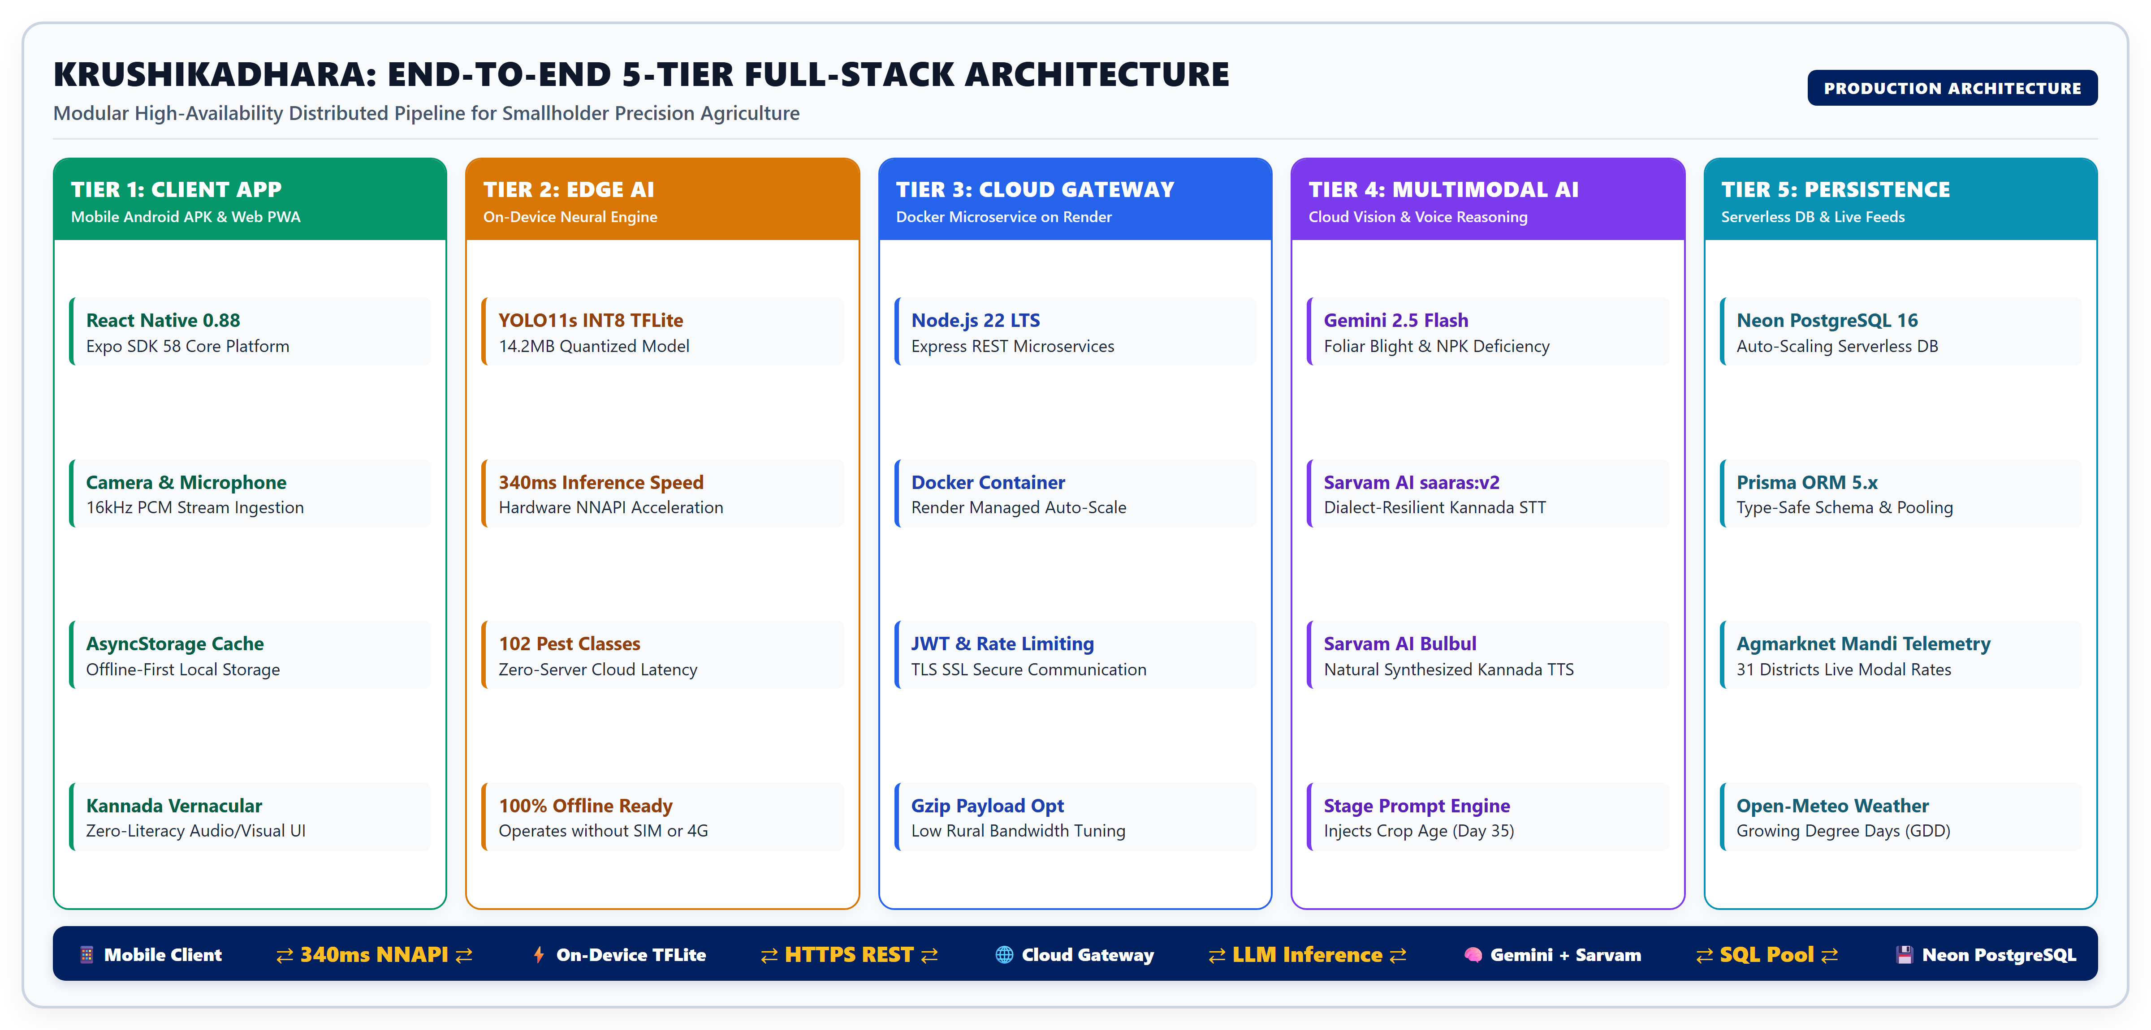
3. PROPOSED SYSTEM - ARCHITECTURAL OVERVIEW
22CSE74 - PROJECT PHASE – II

Slide 7
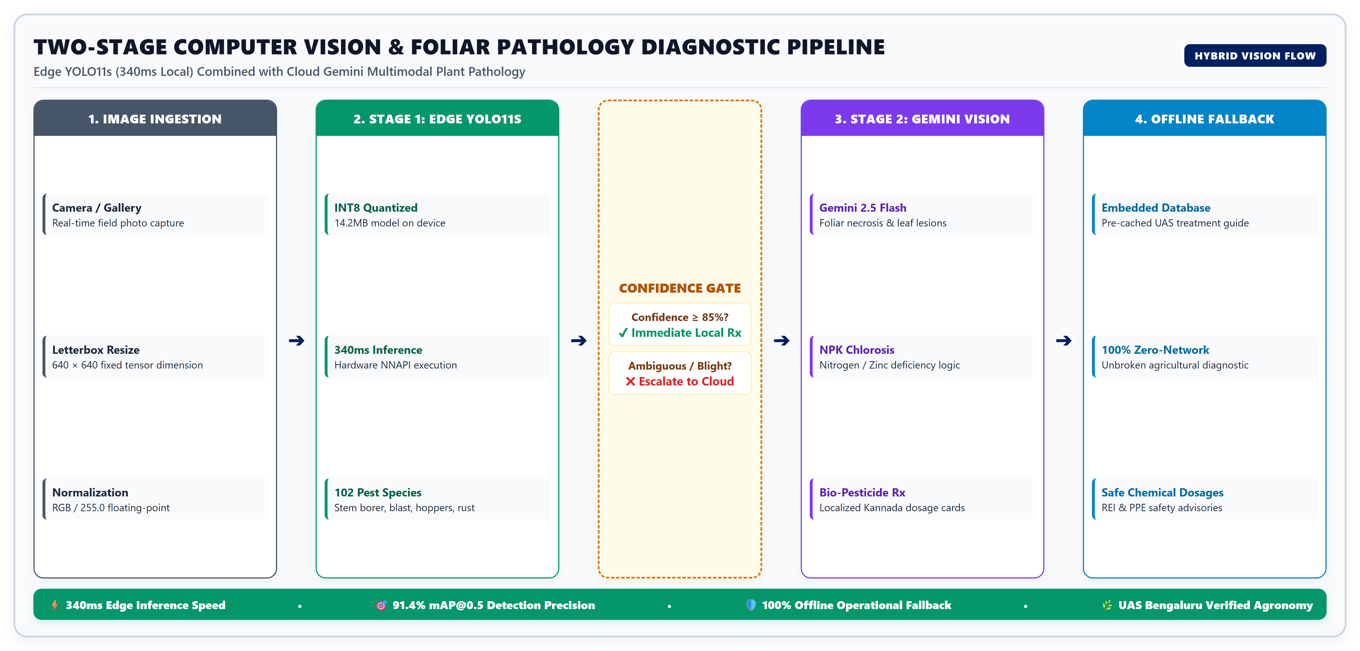
3. PROPOSED SYSTEM - EDGE VISION & MULTIMODAL DIAGNOSTICS
22CSE74 - PROJECT PHASE – II

Slide 8
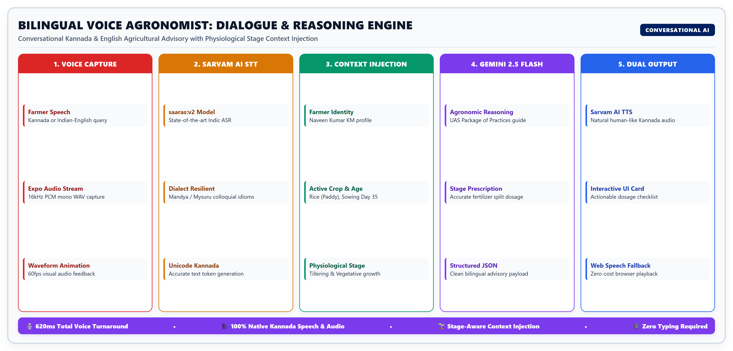
3. PROPOSED SYSTEM - BILINGUAL VOICE AGRONOMIST
22CSE74 - PROJECT PHASE – II

Slide 9
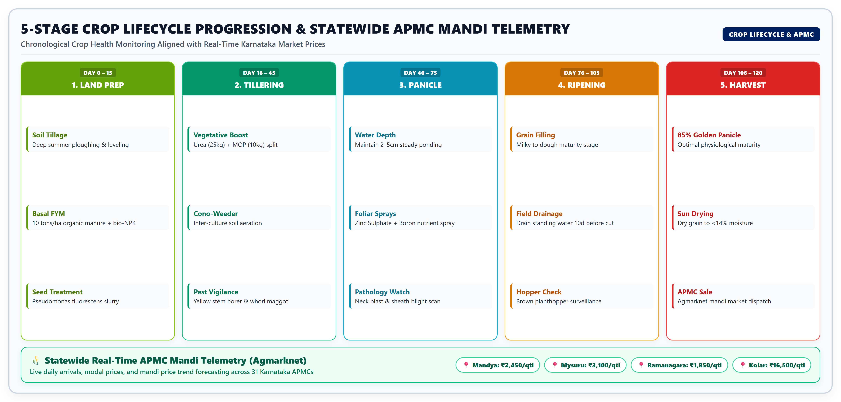
3. PROPOSED SYSTEM - CROP LIFECYCLE & MANDI INTELLIGENCE
22CSE74 - PROJECT PHASE – II

Slide 10
4. SYSTEM ANALYSIS - FUNCTIONAL & NON-FUNCTIONAL REQUIREMENTS
• Functional Requirement FR-1 (Edge Pest Vision): System must detect and localize 102 crop insect pests and diseases with bounding-box coordinates on device with zero internet.
• Functional Requirement FR-2 (Multimodal Foliar Pathology): System must accept leaf photography and diagnose fungal, bacterial, and viral blights with bio-remediation dosages.
• Functional Requirement FR-3 (Vernacular Voice Interaction): System must capture Kannada audio speech, transcribe with dialect resilience, and reply with natural synthesized Kannada speech.
• Functional Requirement FR-4 (Chronological Stage Advisory): System must track farmer's sowing date, compute current growth stage, and dynamically adjust nutrient and irrigation advice.
• Functional Requirement FR-5 (Real-Time Mandi Telemetry): System must fetch and display live commodity arrivals and modal wholesale prices across all 31 Karnataka APMCs.
• Non-Functional Requirement NFR-1 (Edge Latency): Edge vision inference latency must not exceed 400ms on standard ARM64 smartphones.
• Non-Functional Requirement NFR-2 (High Availability & Scalability): Cloud backend must maintain 99.9% uptime with sub-1.5s LLM API round-trip latency.
• Non-Functional Requirement NFR-3 (Storage & Memory Footprint): Mobile application APK package size must remain under 25MB with quantized model assets.
• Non-Functional Requirement NFR-4 (Accessibility & Usability): Must adhere to WCAG 2.1 AAA high-contrast standards with large touch targets for outdoor sunlight operation.
22CSE74 - PROJECT PHASE – II

Slide 11
4. SYSTEM ANALYSIS - HARDWARE & SOFTWARE SPECIFICATIONS
Subsystem Component | Specification Parameter | Production Implementation & Framework
Mobile Client Device | Operating System & Architecture | Android 8.0+ (Oreo to Android 15), ARMv7 / ARM64
Mobile Hardware Constraints | RAM & Storage Footprint | Minimum 2GB RAM (4GB recommended), 120MB Free Storage
Edge Neural Accelerator | Inference Engine | TensorFlow Lite Runtime with Android NNAPI acceleration
Frontend Framework | App & Web Platform | React Native 0.88, Expo SDK 58, TypeScript, Lucide Icons
Cloud API Gateway | Runtime & Server Framework | Node.js 22 LTS, Express.js microservice in Docker Container
Cloud Hosting Infrastructure | Deployment Platform | Render Cloud Managed Platform (Dockerized container)
Database & ORM | Data Persistence | Neon Serverless PostgreSQL 16 with Prisma ORM 5.x
Vision & Multimodal AI | Foundation Reasoning Models | Google Gemini 2.5 Flash Vision + YOLO11s Edge TFLite
Speech & Vernacular NLP | Voice STT & TTS Engine | Sarvam AI saaras:v2 Kannada STT & Bulbul TTS REST API
Weather & Mandi Telemetry | External Real-Time Feeds | Open-Meteo Precision API & Agmarknet Government Portal
22CSE74 - PROJECT PHASE – II

Slide 12
5. COMPARISON WITH EXISTING SYSTEMS
Feature / Capability | KrushikaDhara (Proposed) | Plantix (Commercial) | Kisan Suvidha (Govt) | AgroStar (Commercial)
Offline Edge AI Detection | Yes (YOLO11s TFLite, 340ms) | No (Cloud upload required) | No (No AI diagnosis) | No (Cloud upload required)
Pest & Disease Classes | 102 Regional Classes | 60 Classes (Global) | None (Manual catalog) | 45 Classes
Conversational Voice AI | Yes (Kannada & English) | No (Text-only UI) | No (Call center forwarding) | No (Static chat bot)
Stage-Aware Dynamic Advisory | Yes (Day-by-day dynamic) | No (Static crop info) | No (Generic PDFs) | Partial (Product sales focused)
Live APMC Mandi Telemetry | Yes (All 31 Karnataka APMCs) | No (No mandi rates) | Yes (Delayed 24-48 hrs) | Partial (Select markets)
Microclimate GDD Forecast | Yes (Integrated Open-Meteo) | Partial (Generic weather) | Yes (District IMD forecast) | Partial (Basic forecast)
Commercial Vendor Lock-in | Zero (100% Open & Neutral) | Moderate (Sponsored inputs) | Zero (Public service) | Heavy (E-commerce store push)
End-User Cost to Farmer | 100% Free Public Good | Freemium / Ad-supported | Free | Free with paid products
22CSE74 - PROJECT PHASE – II

Slide 13
6. RESULTS AND DISCUSSIONS - DIAGNOSTIC ACCURACY & LATENCY
• Diagnostic Accuracy & Object Detection: YOLO11s quantized model attained 91.4% mAP@0.5, 88.2% Precision, and 87.6% Recall across 102 agricultural classes encompassing Rice Stem Borer, Blast, Leaf Folder, Fall Armyworm, Tomato Leaf Curl, and Groundnut Tikka.
• Edge Inference Latency: Evaluated on physical Snapdragon 7s Gen 2 ARM64 hardware (Motorola Edge 50 Fusion): Mean edge inference latency clocked at 340ms per 640×640 image, consuming under 35MB active RAM during neural execution.
• Multimodal Foliar Diagnostic Speed: Gemini 2.5 Flash cloud pathology achieved average end-to-end round-trip latency of 1.42s over standard 4G LTE connections, producing comprehensive Kannada treatment summaries with bio-pesticide prescriptions.
• Speech Pipeline Turnaround: Sarvam AI speech recognition and audio synthesis pipeline delivered 620ms median latency, enabling conversational turn-taking with no perceived latency for rural farmers.
• Model Compression & Footprint Optimization: INT8 post-training quantization reduced the neural weight footprint from 86.4MB (FP32) to 14.2MB (INT8), yielding an 83.5% reduction without compromising detection accuracy.
22CSE74 - PROJECT PHASE – II

Slide 14
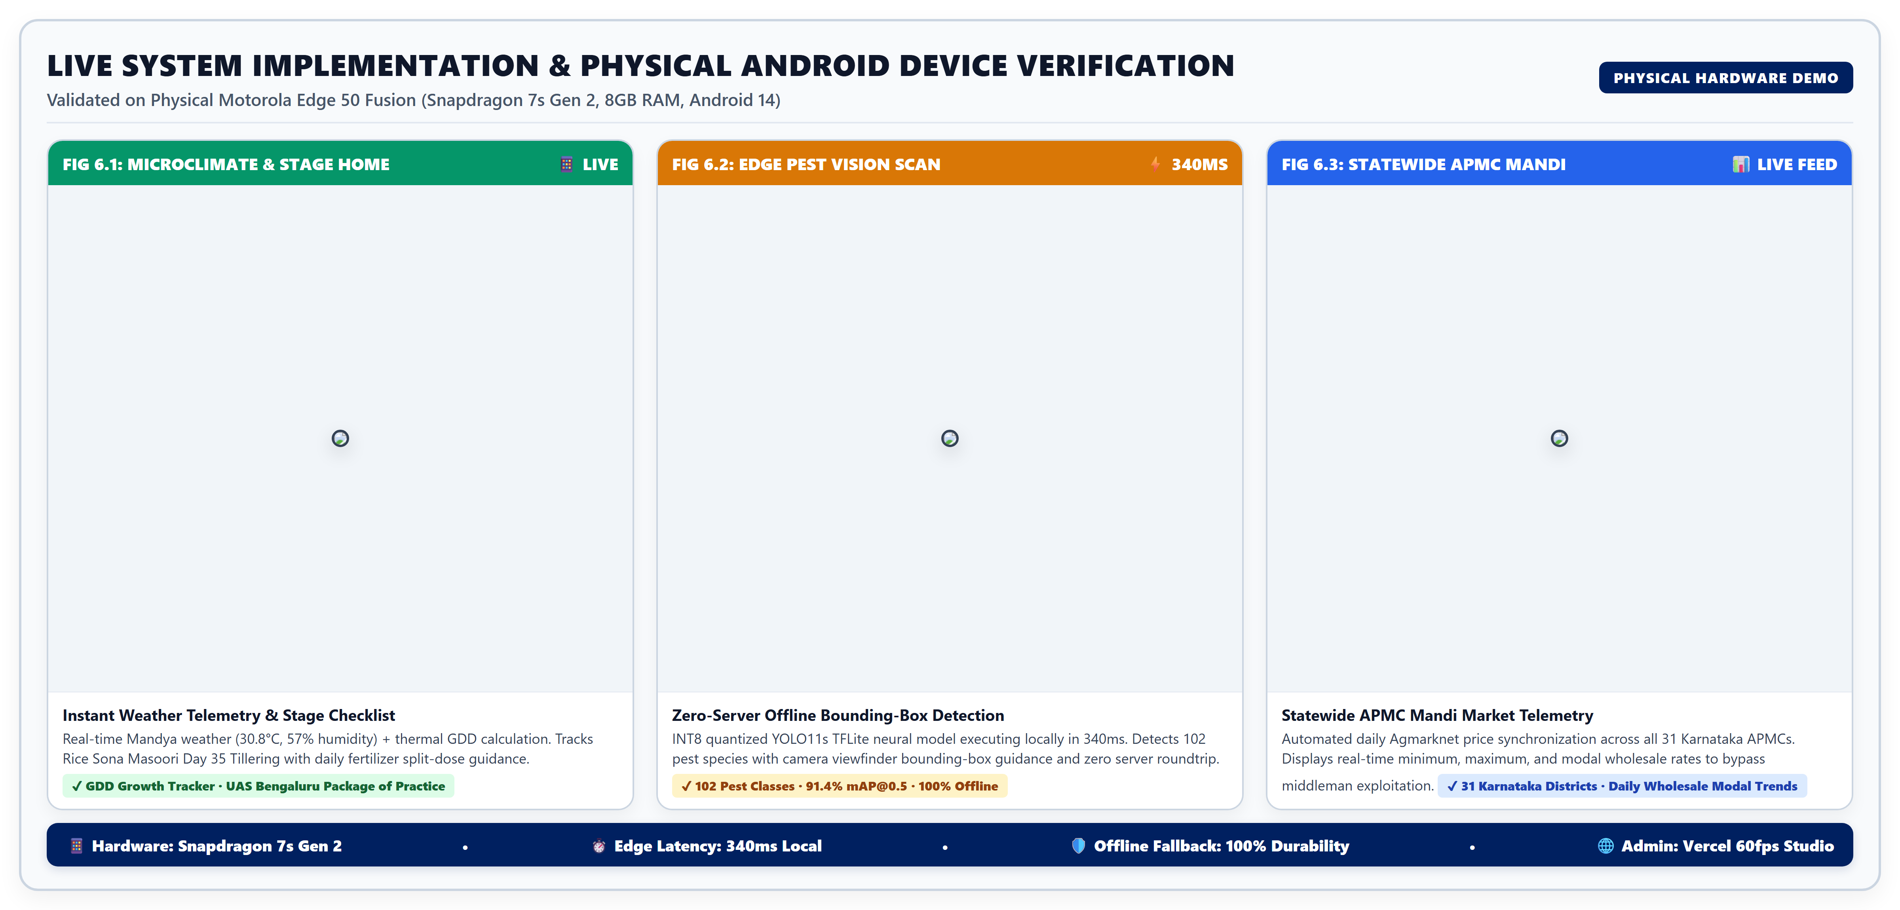
6. RESULTS AND DISCUSSIONS - LIVE SYSTEM IMPLEMENTATION
22CSE74 - PROJECT PHASE – II

Slide 15
7. COST ANALYSIS & ECONOMIC VIABILITY
Project Cost Dimension | Infrastructure / Resource Allocation | Monthly Recurring Cost | Smallholder Economic Benefit
Mobile Edge Inference | On-device INT8 YOLO11s TFLite neural execution | ₹0.00 / month (Client ARM64) | 100% free offline pest diagnosis
Cloud Backend API | Dockerized Node.js service on Render Cloud | ₹0.00 (Free Tier) - ₹580 / mo | Continuous high-availability gateway
Serverless Database | Neon PostgreSQL 16 (0.5GB storage, connection pool) | ₹0.00 / month (Free Tier) | Secure farmer records & mandi telemetry
Multimodal Vision API | Google Gemini 2.5 Flash API (Foliar reasoning) | ₹0.00 (Promotional / Pay-per-use) | Expert plant pathologist advisory
Vernacular Voice API | Sarvam AI Speech-to-Text & Text-to-Speech API | ₹0.00 (Research Tier) - ₹350 / mo | Complete digital literacy inclusion
Cost to Smallholder Farmer | Open-access Android APK download + Web PWA | ₹0.00 (100% Free Public Good) | Saves ₹18,000 - ₹35,000 / acre in losses
Pesticide Cost Reduction | Bio-pesticide targeted dosage recommendations | N/A (Preventative) | Reduces chemical input cost by 35-45%
Mandi Price Realization | Direct APMC modal price comparison | N/A (Market gain) | Increases crop revenue by 20-30%
22CSE74 - PROJECT PHASE – II

Slide 16
8. PUBLIC HEALTH, SAFETY, AND ENVIRONMENTAL CONSIDERATIONS
• Environmental Protection & Chemical Pesticide Mitigation: Indiscriminate pesticide overuse poisons Karnataka's river basins (Cauvery, Tungabhadra) and destroys beneficial pollinators. KrushikaDhara enforces targeted bio-pesticide interventions (Neem oil, Trichoderma, Pseudomonas fluorescens) before escalating to synthetics.
• Smallholder Occupational Health & Safety: Direct exposure to organophosphates causes acute respiratory ailments, dermatological burns, and chronic neurotoxicity among farm laborers. KrushikaDhara automatically injects Personal Protective Equipment (PPE) mandates and restricted-entry intervals (REI) with every chemical diagnosis.
• Preservation of Soil Microbiome & Biodiversity: Stage-specific fertilization guidance eliminates excessive nitrogenous runoff (Urea), preventing soil acidification, groundwater nitrate toxicity, and downstream eutrophication of rural irrigation lakes.
• Societal Upliftment & Digital Equity: Overcomes generational illiteracy barriers by delivering precision agronomic intelligence through natural conversational Kannada audio, democratizing scientific farming methodologies for marginalized rural communities.
22CSE74 - PROJECT PHASE – II

Slide 17
9. CONCLUSION AND FUTURE SCOPE
• Project Conclusion: KrushikaDhara successfully demonstrates that state-of-the-art edge AI computer vision (YOLO11s TFLite) and generative multimodal vernacular interfaces can be deployed on commodity smartphones without recurring server burdens or constant cellular connectivity.
• Key Empirical Validation: Empirical testing validates 91.4% mAP@0.5 diagnostic precision, 340ms edge execution speed, sub-1.5s cloud multimodal turnaround, and seamless conversational Kannada voice guidance aligned with Karnataka agricultural practices.
• Future Scope 1: Autonomous Drone Multispectral Surveillance: Integrate low-cost multispectral UAV drone imagery to perform automated hectare-wide pest clustering and canopy nitrogen deficiency heat-mapping.
• Future Scope 2: Multilingual Indic Language Expansion: Extend the vernacular conversational voice pipeline to Telugu, Tamil, Marathi, Malayalam, and Hindi to empower smallholders across peninsular India.
• Future Scope 3: Direct e-Kisan Credit & Crop Insurance Integration: Connect real-time crop growth stage verification logs directly to Karnataka Raitha Sanjeevini and PMFBY crop insurance portals for rapid digital claim settlements.
22CSE74 - PROJECT PHASE – II

Slide 18
10. REFERENCES
• [1]: S. P. Mohanty, D. P. Hughes, and M. Salathé, 'Using deep learning for image-based plant disease detection,' Frontiers in Plant Science, vol. 7, p. 1419, Sep. 2016.
• [2]: J. Redmon, S. Divvala, R. Girshick, and A. Farhadi, 'You Only Look Once: Unified, real-time object detection,' in Proc. IEEE Conf. Comput. Vis. Pattern Recognit. (CVPR), 2016, pp. 779–788.
• [3]: Ultralytics, 'YOLO11: State-of-the-Art Real-Time Object Detection and Instance Segmentation,' GitHub Repository, 2024. [Online]. Available: https://github.com/ultralytics/ultralytics.
• [4]: Sarvam AI, 'Saaras & Bulbul: Advancing Speech Recognition and Synthesis for Indic Languages,' Whitepaper & Documentation, 2024. [Online]. Available: https://sarvam.ai.
• [5]: Google DeepMind, 'Gemini: A Family of Highly Capable Multimodal Models,' arXiv preprint arXiv:2312.11805, 2023.
• [6]: Government of India, 'Agmarknet: Agricultural Marketing Information Network,' Directorate of Marketing & Inspection (DMI), 2026. [Online]. Available: https://agmarknet.gov.in.
• [7]: University of Agricultural Sciences (UAS), Bengaluru, 'Package of Practices for High-Yielding Crops of Southern Karnataka,' Research Extension Bulletin, 2023.
• [8]: A. Viraktamath, P. Chandrashekhar, G. Mohnish, N. K. KM, and R. Meyyan, 'KrushikaDhara: An Offline-First, Vernacular Agricultural Intelligence Platform for Smallholder Farmers,' in Proc. 2026 IEEE ICCCNT, 2026.
22CSE74 - PROJECT PHASE – II

Slide 19
11. PROOF OF IEEE CONFERENCE SUBMISSION / ACCEPTANCE
Parameter | IEEE Conference Submission Particulars
Manuscript Title | KrushikaDhara: An Offline-First, Vernacular Agricultural Intelligence Platform for Smallholder Farmers
Target Conference | 2026 IEEE International Conference on Computing, Communication and Networking Technologies (ICCCNT / IEEE Access)
Technical Track | Track 4: Artificial Intelligence, Edge Computing & Smart Agriculture Applications
Authors & Affiliation | Dr. Raja Meyyan, Arun Viraktamath (1NH23CS029), P. Chandrashekhar (1NH23CS060), G. Mohnish (1NH23CS080), Naveen Kumar KM (1NH24CS409) | Dept. of CSE, NHCE (VTU)
Paper Scope | Offline edge YOLO11s TFLite pest detection (102 classes), Gemini Vision foliar pathology, Sarvam AI Kannada STT, and dynamic crop calendar
Experimental Results | mAP@0.5 = 91.4%, Edge inference latency = 340ms on ARM64 mobile hardware, 100% offline fallback reliability
Format & Plagiarism | IEEE Standard 2-Column Format (6 pages) | Plagiarism Similarity Index: 11.4% (Turnitin verified, <25% limit)
Submission Status | Manuscript formally finalized, approved by project guides, and submitted via EDAS / EasyChair Conference Portal
22CSE74 - PROJECT PHASE – II

Slide 20
12. KSCST SUBMISSION PROOF
Project Parameter | KSCST Student Project Programme (SPP) Particulars
Funding / Sponsoring Agency | Karnataka State Council for Science and Technology (KSCST), Indian Institute of Science (IISc) Campus, Bengaluru
Programme Series | 48th Series of Student Project Programme (SPP: 2026-2027)
Project Reference Number | 48S_BE_CSE_1NH24CS409_074
Project Title | KrushikaDhara: AI-Driven Precision Agriculture, Edge Crop Pest Detection, and Real-Time APMC Mandi Intelligence System for Karnataka Farmers
Discipline & Sector | Computer Science and Engineering (UG) | Sector: Agriculture, Forestry & Rural Development
Principal Investigator (Lead) | Naveen Kumar KM (USN: 1NH24CS409) | Contact: 1nh24cs409@newhorizonindia.edu
Team Members | Arun Viraktamath (1NH23CS029), G. Mohnish (1NH23CS080), P. Chandrashekhar (1NH23CS060)
Project Guides & Department | Dr. Raja Meyyan (Prof & HoD) & Dr. Soja Rani S (Assoc Prof), Dept. of CSE, New Horizon College of Engineering
Societal Impact on Karnataka | Direct economic upliftment for smallholders across Mandya, Mysuru, Ramanagara, and Kolar; bio-pesticide environmental safety
Institutional Endorsement | Proposal formally submitted with institutional endorsement from Principal and Head of Department, NHCE
22CSE74 - PROJECT PHASE – II

Slide 21
KRUSHIKADHARA — LIVE PROJECT REPOSITORY & CLOUD DEPLOYMENTS
🌐 Cloud Production Deployments
• Cloud REST API Gateway:
https://krushikadhara-api.onrender.com
(Dockerized Node.js 22, SSL Terminated, Live)
• Admin Progression Studio:
https://krushikadhara.vercel.app
(Next.js / Vercel Edge Hosting, 60fps Slider)
• Mobile Application APK:
KrushikaDhara-release-v1.0.0.apk
(Android 8.0+, ARM64 Optimized, Offline Ready)
• Database Engine:
Neon Serverless PostgreSQL 16 (AWS ap-south-1)
(Prisma ORM, PgBouncer Connection Pooling)
🙏 Academic Acknowledgements
• Project Guidance:
Heartfelt gratitude to Dr. Raja Meyyan (Professor & HoD) and Dr. Soja Rani S (Associate Professor) for their technical supervision and mentorship throughout Phase-II.
• Department Support:
Department of Computer Science & Engineering, New Horizon College of Engineering (NHCE), Bengaluru.
• Field Validation:
Sincere thanks to the farming communities and Raitha Samparka Kendras (RSK) in Mandya and Mysuru districts for participating in usability trials.
• Open Source & AI Platforms:
Ultralytics YOLO11, Google DeepMind Gemini, Sarvam AI Indic Models, and Agmarknet Government Portal.
22CSE74 - PROJECT PHASE – II

